Slide 1
Biological Networks Analysis Introduction and Dijkstra’s algorithm
Genome 559: Introduction to Statistical and Computational Genomics
Elhanan Borenstein

Slide 2
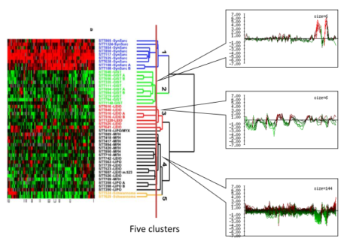
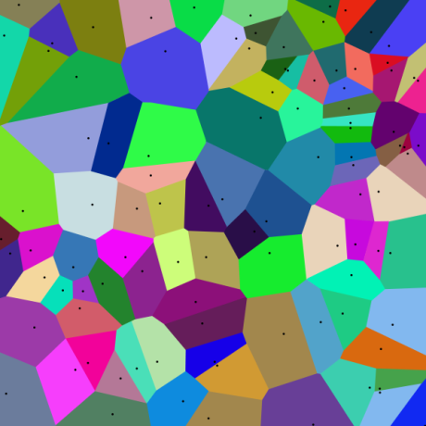
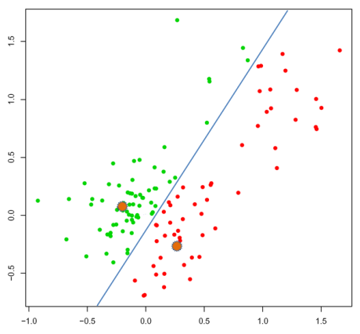
A quick review
The clustering problem:
partition genes into distinct sets with high homogeneity and high separation
Hierarchical clustering algorithm:
Assign each object to a separate cluster.
Regroup the pair of clusters with shortest distance.
Repeat 2 until there is a single cluster.
Many possible distance metrics
K-mean clustering algorithm:
Arbitrarily select k initial centers
Assign each element to the closest center
Voronoi diagram
Re-calculate centers (i.e., means)
Repeat 2 and 3 until termination condition reached

Slide 3
Biological networks
What is a network?
What networks are used in biology?
Why do we need networks (and network theory)?
How do we find the shortest path between two nodes?

Slide 4
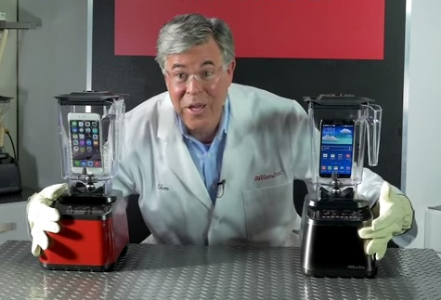
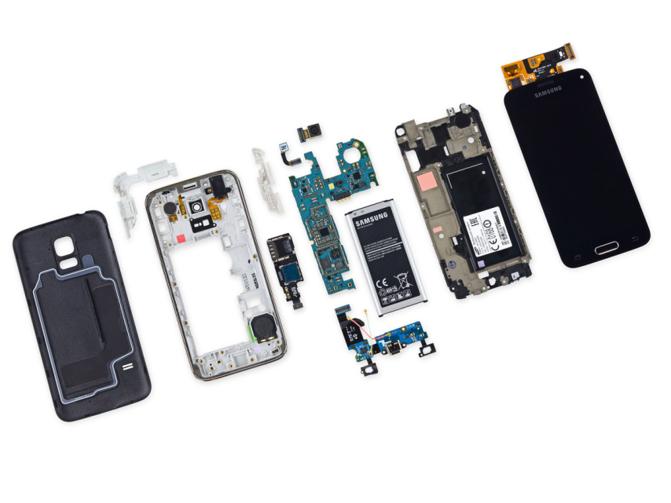
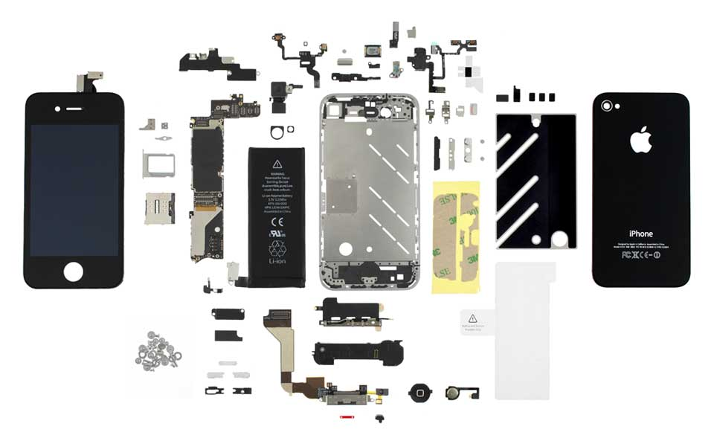
Why we need networks (and systems biology)?
VS.
Notes:
Going back to the question of how does it all work, I want to argue that ..

Slide 5
What is a network?
A map of interactions or relationships
A collection of nodes and links (edges)

Slide 6

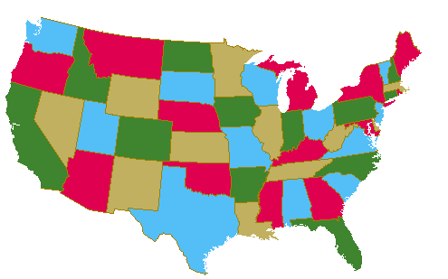
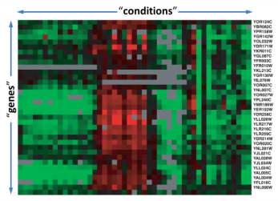
Networks vs. Graphs
Network theory |  | Graph theory
Social sciences Biological sciences |  | Computer science
Mostly 20th century |  | Since 18th century!!!
Modeling real-life systems |  | Modeling abstract systems
Measuring structure & topology |  | Solving “graph-related” questions
Notes:
From now on we will use these terms interchangeably

Slide 7
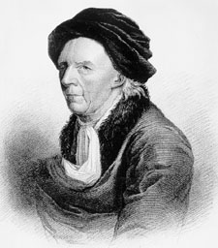
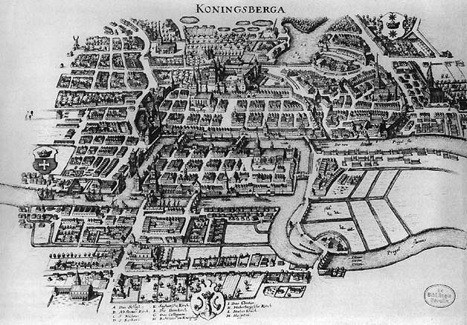
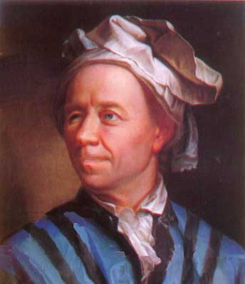

The Seven Bridges of Königsberg
Published by Leonhard Euler, 1736
Considered the first paper in graph theory
Leonhard Euler 1707 –1783

Slide 8
The Seven Bridges of Königsberg
Published by Leonhard Euler, 1736
Considered the first paper in graph theory
Leonhard Euler 1707 –1783

Slide 9
What is a network?
A map of interactions or relationships
A collection of nodes and links (edges)

Slide 10
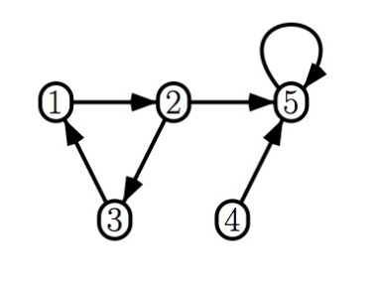
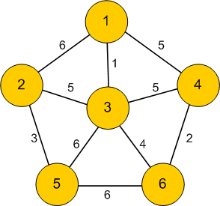
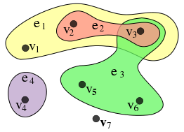
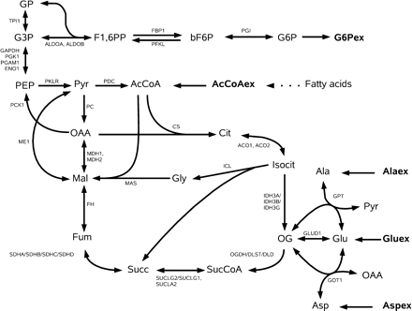
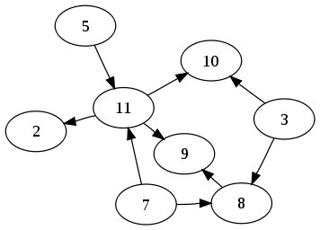
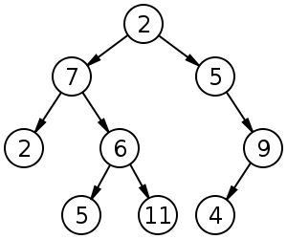
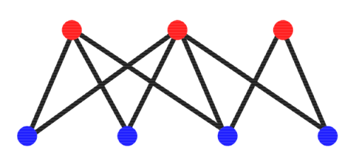
Types of networks
Edges:
Directed/undirected
Weighted/non-weighted
(Simple-edges/Hyperedges)
Special topologies:
Directed Acyclic Graphs (DAG)
Trees
Bipartite networks
Notes:
3 important factor: directionality, Weight, Cycles

Slide 11
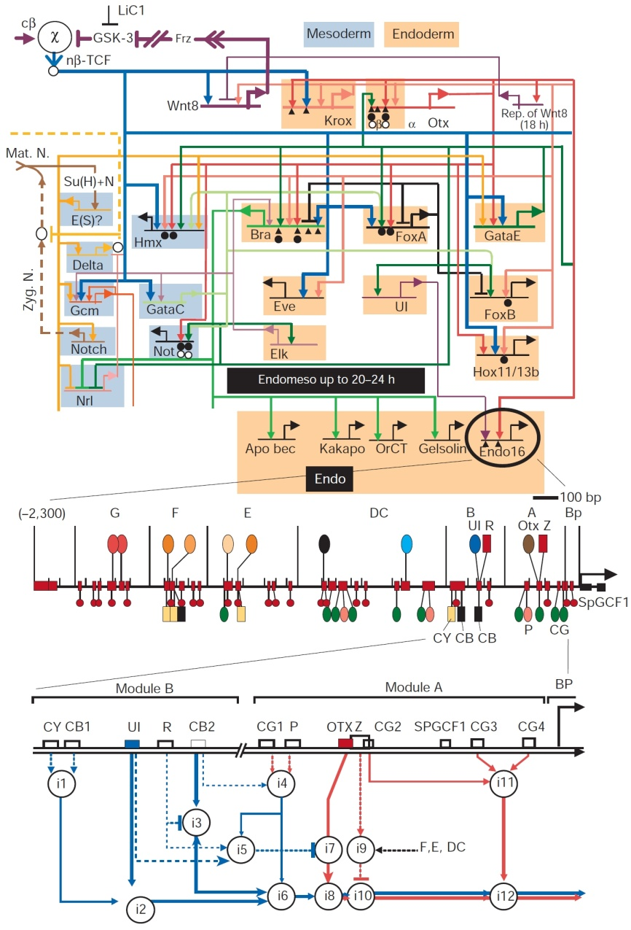
Transcriptional regulatory networks
Reflect the cell’s genetic regulatory circuitry
Nodes: transcription factors and genes;
Edges: from TF to the genes it regulates
Directed; weighted?; “almost” bipartite
Derived through:
Chromatin IP
Microarrays
Computationally

Slide 12
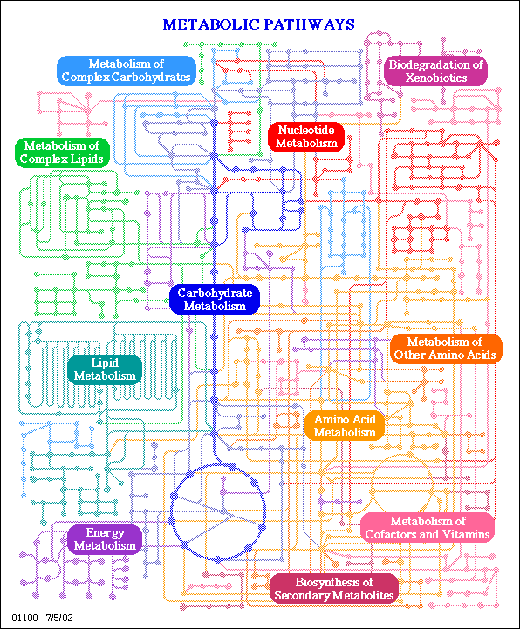
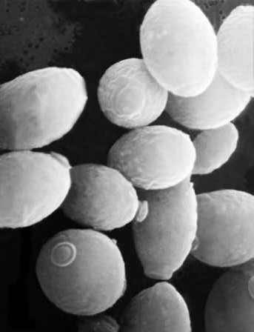
Metabolic networks
Reflect the set of biochemical reactions in a cell
Nodes: metabolites
Edges: biochemical reactions
Directed; weighted?; hyperedges?
Derived through:
Knowledge of biochemistry
Metabolic flux measurements
Homology?
S. Cerevisiae
1062 metabolites
1149 reactions

Slide 13
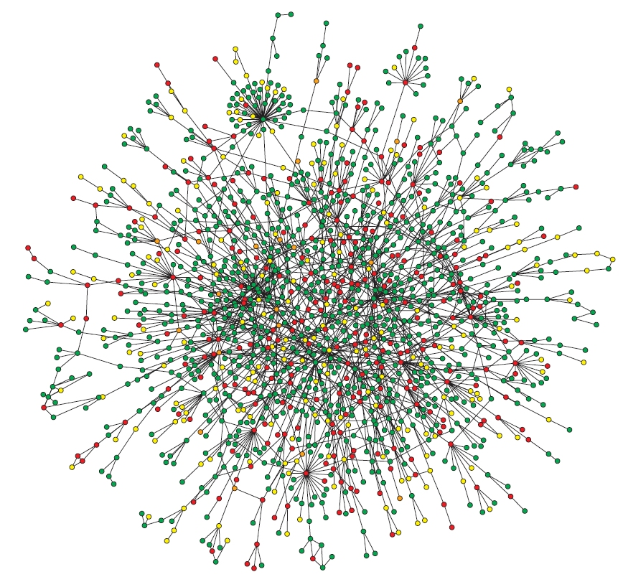
Protein-protein interaction (PPI) networks
Reflect the cell’s molecular interactions and signaling pathways (interactome)
Nodes: proteins
Edges: interactions(?)
Undirected
High-throughput experiments:
Protein Complex-IP (Co-IP)
Yeast two-hybrid
Computationally
S. Cerevisiae
4389 proteins
14319 interactions
Notes:
Protein complex immunoprecipitation (Co-IP)

Slide 14
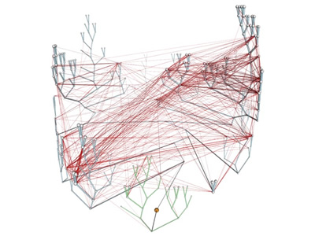
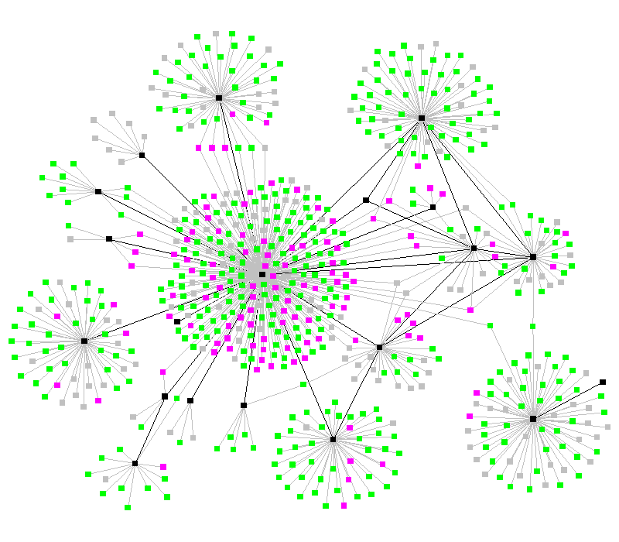
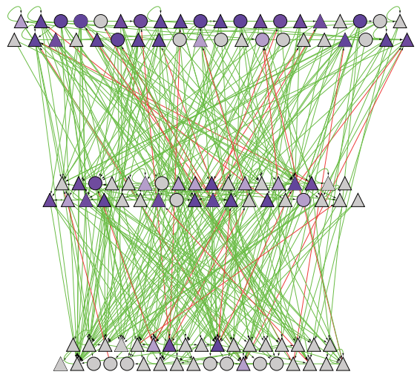
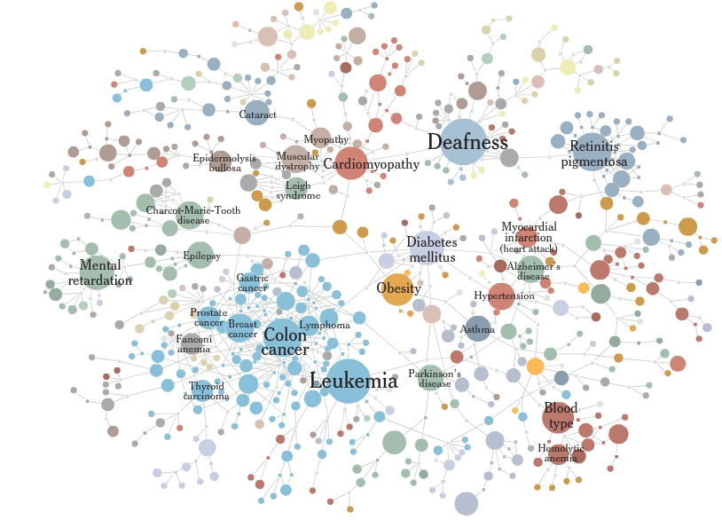
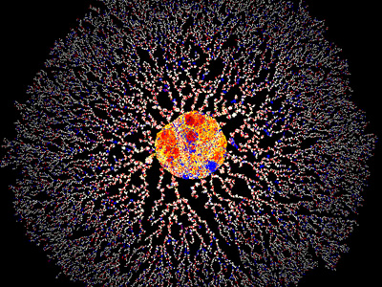
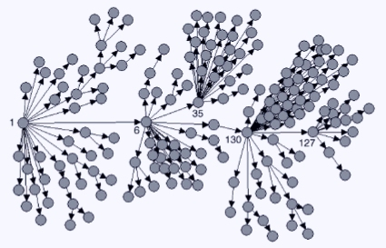
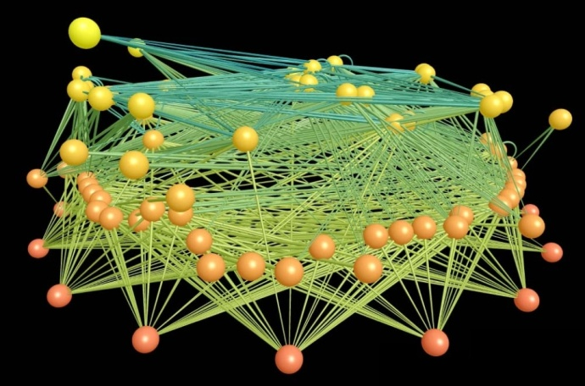
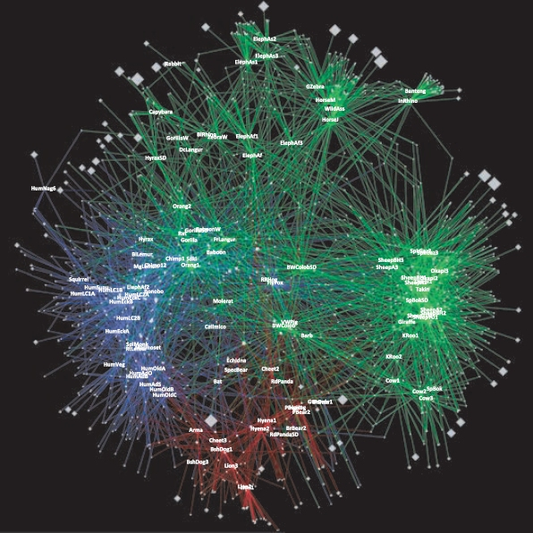
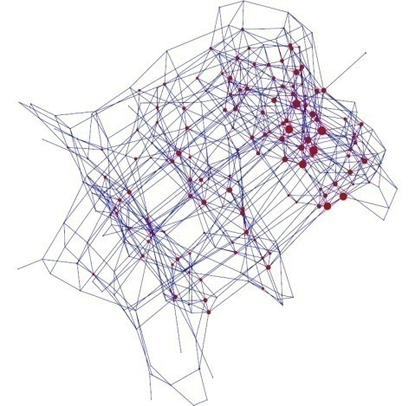
Other networks in biology/medicine
Notes:
PROTEIN HOMOLOGY NETWORK

Slide 15
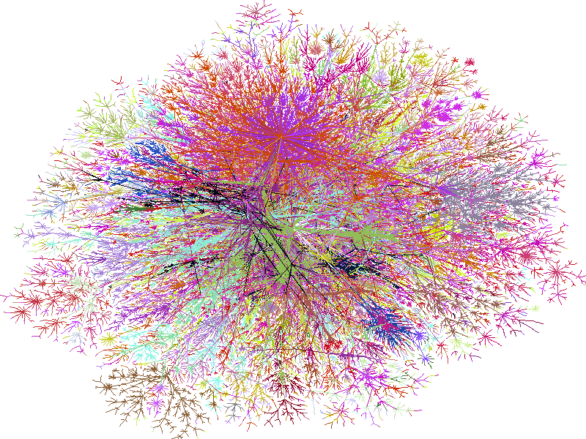
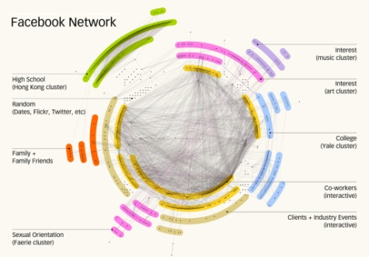
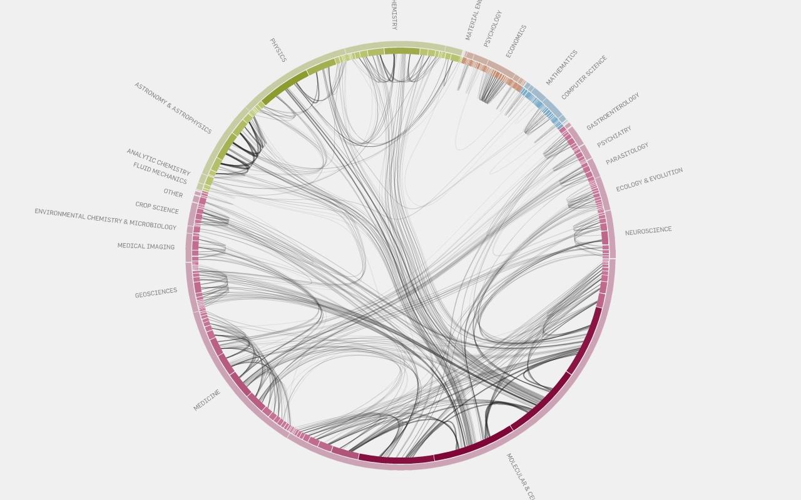
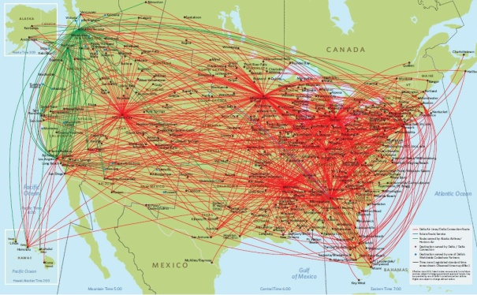
Non-biological networks
Computer related networks:
WWW; Internet backbone
Communications and IP
Social networks:
Friendship (facebook; clubs)
Citations / information flow
Co-authorships (papers)
Co-occurrence (movies; Jazz)
Transportation:
Highway systems; Airline routes
Electronic/Logic circuits
Many many more…

Slide 16
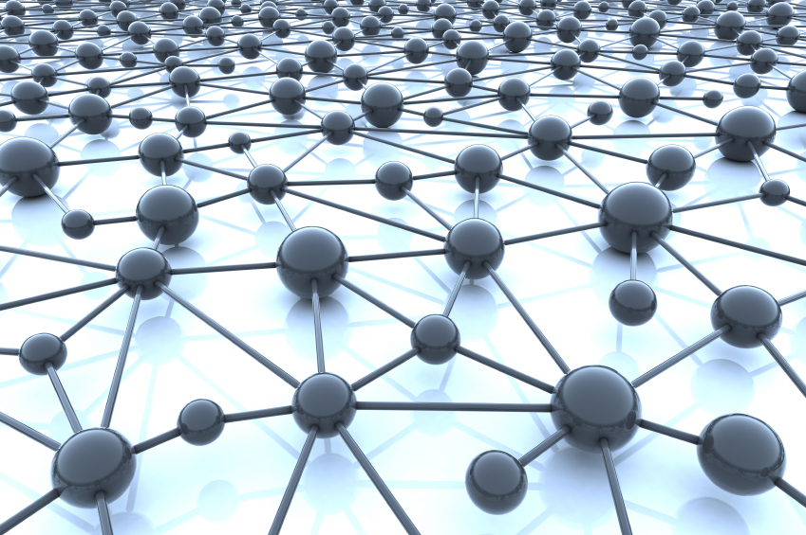

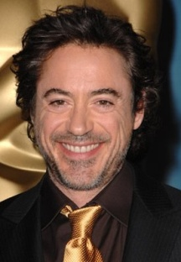
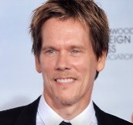
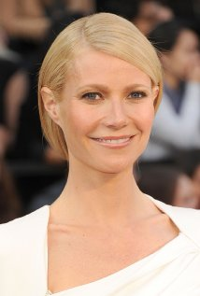

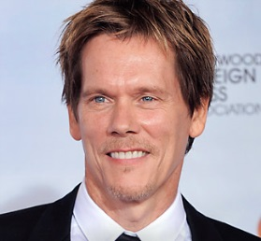
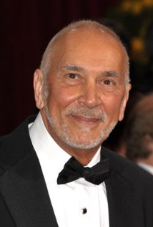
An Oscar Special: The Bacon Number Game
Tropic Thunder (2008)
Tropic Thunder
Iron Man
Proof
Flatliners
Tom Cruise
Robert Downey Jr.
Gwyneth Paltrow
Hope Davis
Kevin Bacon
Tropic Thunder
Iron Man
Frost/Nixon
Tom Cruise
Robert Downey Jr.
Frank Langella
Kevin Bacon
Notes:
Gwyneth Paltrow
Frank Langella

Slide 17
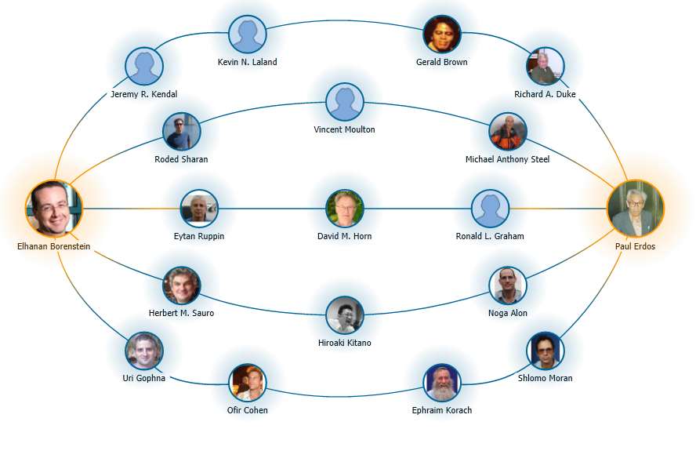
The Paul Erdos Number Game

Slide 18
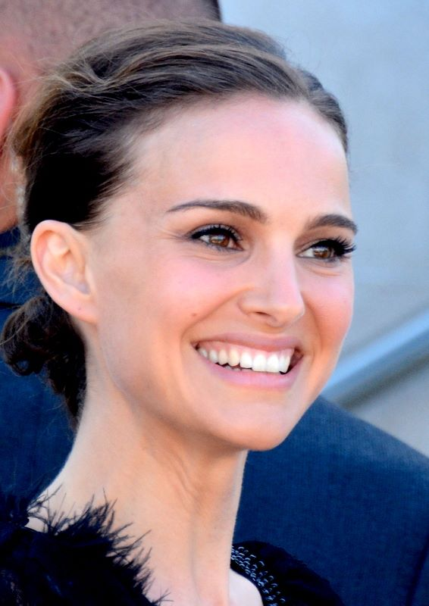
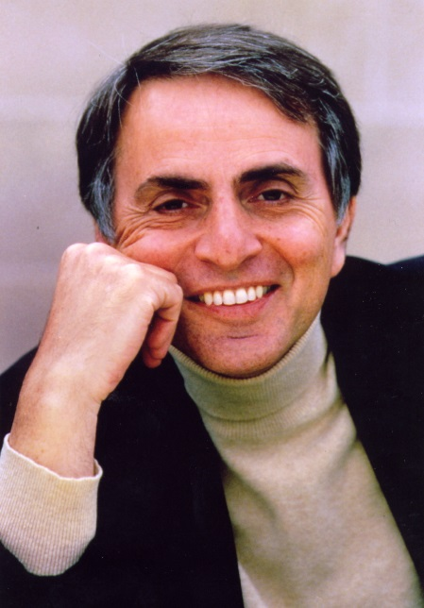
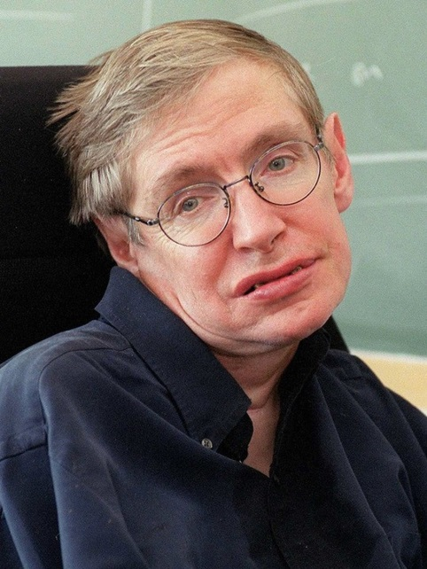
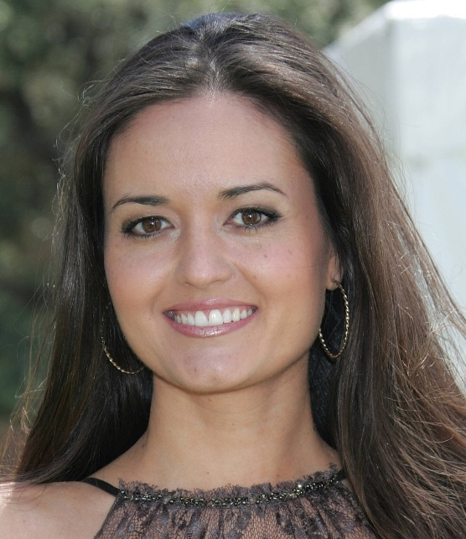

Slide 19
7 6 6 6

Slide 20
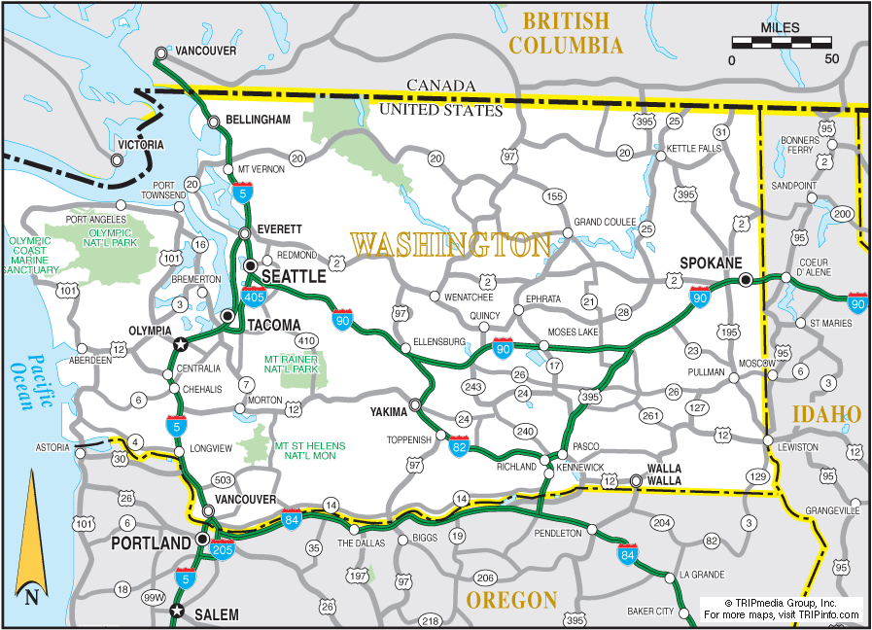
The shortest path problem
Find the minimal number of “links” connecting node A to node B in an undirected network
How many friends between you and someone on FB (six degrees of separation, Erdös number, Kevin Bacon number)
How far apart are two genes in an interaction network
What is the shortest (and likely) infection path
Find the shortest (cheapest) path between two nodes in a weighted directed graph
GPS; Google map

Slide 21
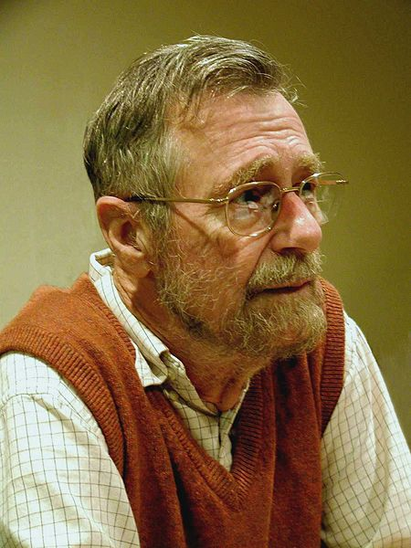
Dijkstra’s Algorithm
"Computer Science is no more about computers than astronomy is about telescopes."
Edsger Wybe Dijkstra 1930 –2002

Slide 22
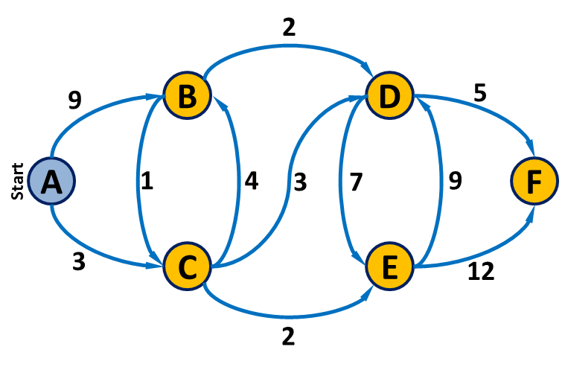
Dijkstra’s algorithm
Solves the single-source shortest path problem:
Find the shortest path from a single source to ALL nodes in the network
Works on both directed and undirected networks
Works on both weighted and non-weighted networks
Approach:
Iterative : maintain shortest path to each intermediate node
Greedy algorithm
… but still guaranteed to provide optimal solution !!

Slide 23
Dijkstra’s algorithm
Initialize:
Assign a distance value, D, to each node. Set D to zero for start node and to infinity for all others.
Mark all nodes as unvisited.
Set start node as current node.
For each of the current node’s unvisited neighbors:
Calculate tentative distance, D^{t}, through current node.
If D^{t} smaller than D (previously recorded distance): D← D^{t}
Mark current node as visited (note: shortest dist. found).
Set the unvisited node with the smallest distance as the next "current node" and continue from step 2.
Once all nodes are marked as visited, finish.

Slide 24
Dijkstra’s algorithm
A simple synthetic network
2
9
B
D
5
A
1
4
3
7
9
F
3
C
E
12
Initialize:
Assign a distance value, D, to each node. Set D to zero for start node and to infinity for all others.
Mark all nodes as unvisited.
Set start node as current node.
For each of the current node’s unvisited neighbors:
Calculate tentative distance, D^{t}, through current node.
If D^{t} smaller than D (previously recorded distance): D← D^{t}
Mark current node as visited (note: shortest dist. found).
Set the unvisited node with the smallest distance as the next "current node" and continue from step 2.
Once all nodes are marked as visited, finish.
2

Slide 25
Dijkstra’s algorithm
Initialization
Mark A (start) as current node
2
A | B | C | D | E | F
0 | ∞ | ∞ | ∞ | ∞ | ∞
D: ∞
D: ∞
9
B
D
5
A
1
4
3
7
9
F
D: 0
D: ∞
3
C
E
12
D: ∞
D: ∞
2

Slide 26
Dijkstra’s algorithm
Check unvisited neighbors of A
2
0+9 vs. ∞
D: ∞
D: ∞
A | B | C | D | E | F
0 | ∞ | ∞ | ∞ | ∞ | ∞
9
B
D
5
A
1
4
3
7
9
F
D: 0
D: ∞
3
C
E
12
D: ∞
D: ∞
0+3 vs. ∞
2

Slide 27
Dijkstra’s algorithm
Update D
Record path
2
A | B | C | D | E | F
0 | ∞ | ∞ | ∞ | ∞ | ∞
0 | 9 | 3 | ∞ | ∞ | ∞
D: ∞,9
D: ∞
9
B
D
5
A
1
4
3
7
9
F
D: 0
D: ∞
3
C
E
12
D: ∞,3
D: ∞
2

Slide 28
Dijkstra’s algorithm
Mark A as visited …
2
A | B | C | D | E | F
0 | ∞ | ∞ | ∞ | ∞ | ∞
0 | 9 | 3 | ∞ | ∞ | ∞
D: ∞,9
D: ∞
9
B
D
5
A
1
4
3
7
9
F
D: 0
D: ∞
3
C
E
12
D: ∞,3
D: ∞
2

Slide 29
Dijkstra’s algorithm
Mark C as current (unvisited node with smallest D)
2
A | B | C | D | E | F
0 | ∞ | ∞ | ∞ | ∞ | ∞
0 | 9 | 3 | ∞ | ∞ | ∞
D: ∞,9
D: ∞
9
B
D
5
A
1
4
3
7
9
F
D: 0
D: ∞
3
C
E
12
D: ∞,3
D: ∞
2

Slide 30
Dijkstra’s algorithm
Check unvisited neighbors of C
2
3+3 vs. ∞
3+4 vs. 9
D: ∞,9
D: ∞
A | B | C | D | E | F
0 | ∞ | ∞ | ∞ | ∞ | ∞
0 | 9 | 3 | ∞ | ∞ | ∞
9
B
D
5
A
1
4
3
7
9
F
D: 0
D: ∞
3
C
E
12
D: ∞,3
D: ∞
2
3+2 vs. ∞

Slide 31
Dijkstra’s algorithm
Update distance
Record path
2
A | B | C | D | E | F
0 | ∞ | ∞ | ∞ | ∞ | ∞
0 | 9 | 3 | ∞ | ∞ | ∞
 | 7 | 3 | 6 | 5 | ∞
D: ∞,9,7
D: ∞,6
9
B
D
5
A
1
4
3
7
9
F
D: 0
D: ∞
3
C
E
12
D: ∞,3
D: ∞,5
2

Slide 32
Dijkstra’s algorithm
Mark C as visited
Note: Distance to C is final!!
2
A | B | C | D | E | F
0 | ∞ | ∞ | ∞ | ∞ | ∞
0 | 9 | 3 | ∞ | ∞ | ∞
 | 7 | 3 | 6 | 5 | ∞
D: ∞,9,7
D: ∞,6
9
B
D
5
A
1
4
3
7
9
F
D: 0
D: ∞
3
C
E
12
D: ∞,3
D: ∞,5
2

Slide 33
Dijkstra’s algorithm
Mark E as current node
Check unvisited neighbors of E
2
A | B | C | D | E | F
0 | ∞ | ∞ | ∞ | ∞ | ∞
0 | 9 | 3 | ∞ | ∞ | ∞
 | 7 | 3 | 6 | 5 | ∞
D: ∞,9,7
D: ∞,6
9
B
D
5
A
1
4
3
7
9
F
D: 0
D: ∞
3
C
E
12
D: ∞,3
D: ∞,5
2

Slide 34
Dijkstra’s algorithm
Update D
Record path
2
A | B | C | D | E | F
0 | ∞ | ∞ | ∞ | ∞ | ∞
0 | 9 | 3 | ∞ | ∞ | ∞
 | 7 | 3 | 6 | 5 | ∞
 | 7 |  | 6 | 5 | 17
D: ∞,9,7
D: ∞,6
9
B
D
5
A
1
4
3
7
9
F
D: 0
D: 0
D: ∞,17
3
C
E
12
D: ∞,3
D: ∞,5
2

Slide 35
Dijkstra’s algorithm
Mark E as visited
2
A | B | C | D | E | F
0 | ∞ | ∞ | ∞ | ∞ | ∞
0 | 9 | 3 | ∞ | ∞ | ∞
 | 7 | 3 | 6 | 5 | ∞
 | 7 |  | 6 | 5 | 17
D: ∞,9,7
D: ∞,6
9
B
D
5
A
1
4
3
7
9
F
D: 0
D: ∞,17
3
C
E
12
D: ∞,3
D: ∞,5
2

Slide 36
Dijkstra’s algorithm
Mark D as current node
Check unvisited neighbors of D
2
A | B | C | D | E | F
0 | ∞ | ∞ | ∞ | ∞ | ∞
0 | 9 | 3 | ∞ | ∞ | ∞
 | 7 | 3 | 6 | 5 | ∞
 | 7 |  | 6 | 5 | 17
D: ∞,9,7
D: ∞,6
9
B
D
5
A
1
4
3
7
9
F
D: 0
D: ∞,17
3
C
E
12
D: ∞,3
D: ∞,5
2

Slide 37
Dijkstra’s algorithm
Update D
Record path (note: path has changed)
2
A | B | C | D | E | F
0 | ∞ | ∞ | ∞ | ∞ | ∞
0 | 9 | 3 | ∞ | ∞ | ∞
 | 7 | 3 | 6 | 5 | ∞
 | 7 |  | 6 | 5 | 17
 | 7 |  | 6 |  | 11
D: ∞,9,7
D: ∞,6
9
B
D
5
A
1
4
3
7
9
F
D: 0
D: ∞,17,11
3
C
E
12
D: ∞,3
D: ∞,5
2

Slide 38
Dijkstra’s algorithm
Mark D as visited
2
A | B | C | D | E | F
0 | ∞ | ∞ | ∞ | ∞ | ∞
0 | 9 | 3 | ∞ | ∞ | ∞
 | 7 | 3 | 6 | 5 | ∞
 | 7 |  | 6 | 5 | 17
 | 7 |  | 6 |  | 11
D: ∞,9,7
D: ∞,6
9
B
D
5
A
1
4
3
7
9
F
D: 0
D: ∞,17,11
3
C
E
12
D: ∞,3
D: ∞,5
2

Slide 39
Dijkstra’s algorithm
Mark B as current node
Check neighbors
2
A | B | C | D | E | F
0 | ∞ | ∞ | ∞ | ∞ | ∞
0 | 9 | 3 | ∞ | ∞ | ∞
 | 7 | 3 | 6 | 5 | ∞
 | 7 |  | 6 | 5 | 17
 | 7 |  | 6 |  | 11
D: ∞,9,7
D: ∞,6
9
B
D
5
A
1
4
3
7
9
F
D: 0
D: ∞,17,11
3
C
E
12
D: ∞,3
D: ∞,5
2

Slide 40
Dijkstra’s algorithm
No updates..
Mark B as visited
2
A | B | C | D | E | F
0 | ∞ | ∞ | ∞ | ∞ | ∞
0 | 9 | 3 | ∞ | ∞ | ∞
 | 7 | 3 | 6 | 5 | ∞
 | 7 |  | 6 | 5 | 17
 | 7 |  | 6 |  | 11
 | 7 |  |  |  | 11
D: ∞,9,7
D: ∞,6
9
B
D
5
A
1
4
3
7
9
F
D: 0
D: ∞,17,11
3
C
E
12
D: ∞,3
D: ∞,5
2

Slide 41
Dijkstra’s algorithm
Mark F as current
2
A | B | C | D | E | F
0 | ∞ | ∞ | ∞ | ∞ | ∞
0 | 9 | 3 | ∞ | ∞ | ∞
 | 7 | 3 | 6 | 5 | ∞
 | 7 |  | 6 | 5 | 17
 | 7 |  | 6 |  | 11
 | 7 |  |  |  | 11
D: ∞,9,7
D: ∞,6
9
B
D
5
A
1
4
3
7
9
F
D: 0
D: ∞,17,11
3
C
E
12
D: ∞,3
D: ∞,5
2

Slide 42
Dijkstra’s algorithm
Mark F as visited
2
A | B | C | D | E | F
0 | ∞ | ∞ | ∞ | ∞ | ∞
0 | 9 | 3 | ∞ | ∞ | ∞
 | 7 | 3 | 6 | 5 | ∞
 | 7 |  | 6 | 5 | 17
 | 7 |  | 6 |  | 11
 | 7 |  |  |  | 11
 |  |  |  |  | 11
D: ∞,9,7
D: ∞,6
9
B
D
5
A
1
4
3
7
9
F
D: 0
D: ∞,17,11
3
C
E
12
D: ∞,3
D: ∞,5
2

Slide 43
We are done!
We now have:
Shortest path from A to each node (both length and path)
2
D: ∞,9,7
D: ∞,6
9
B
D
5
A | B | C | D | E | F
0 | ∞ | ∞ | ∞ | ∞ | ∞
0 | 9 | 3 | ∞ | ∞ | ∞
 | 7 | 3 | 6 | 5 | ∞
 | 7 |  | 6 | 5 | 17
 | 7 |  | 6 |  | 11
 | 7 |  |  |  | 11
 |  |  |  |  | 11
A
1
4
3
7
9
F
D: 0
D: ∞,17,11
3
C
E
12
D: ∞,3
D: ∞,5
2

Slide 44
We are done!
We now have:
Shortest path from A to each node (both length and path)
Minimum spanning tree
2
D: ∞,9,7
D: ∞,6
9
B
D
5
A | B | C | D | E | F
0 | ∞ | ∞ | ∞ | ∞ | ∞
0 | 9 | 3 | ∞ | ∞ | ∞
 | 7 | 3 | 6 | 5 | ∞
 | 7 |  | 6 | 5 | 17
 | 7 |  | 6 |  | 11
 | 7 |  |  |  | 11
 |  |  |  |  | 11
A
1
4
3
7
9
F
D: 0
D: ∞,17,11
3
C
E
12
D: ∞,3
D: ∞,5
2
Will we always get a tree?
Can you prove it?

Slide 46
How would you represent a network in your python code?

Slide 47
Computational Representation of Networks
A
B
C
D
List of edges: (ordered) pairs of nodes [ (A,C) , (C,B) , (D,B) , (D,C) ]
Connectivity Matrix
Object Oriented
 | A | B | C | D
A | 0 | 0 | 1 | 0
B | 0 | 0 | 0 | 0
C | 0 | 1 | 0 | 0
D | 0 | 1 | 1 | 0
Name:D ngr:
Name:C ngr:
Name:A ngr:
p1
p2
p1
Name:B ngr:
p1
Which is the most useful representation?

Slide 48
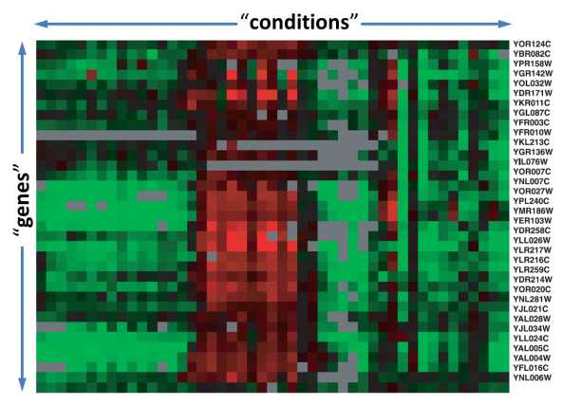
Why networks?
Networks as models
Networks as tools
Simple, visual representation of complex systems
Problem representation (more common than you think)
Focus on organization (rather than on components)
Algorithm development
Discovery (topology affects function)
Predictive models
Diffusion models (dynamics)

